Slide 1
http://a.b.c.d/
http://v.x.y.z/
http://a.b.c.d/healthprobe
http:// v.x.y.z/healthprobe
vmONE
vmTWO

Slide 2
ACTIVE
PASSIVE
Only cluster groups on one cluster node are active at one time. For example, when cluster group 1 is active on cluster node 1 (as in Figure 1), the copy of cluster group 1 on cluster node 2 is inactive. In an active/passive cluster environment with two cluster nodes, only cluster groups on the active cluster node are running. If the active node fails, the cluster groups on the other node are started to continue the work of the cluster groups that were active on the node that failed.

Slide 3
LoadBalancer
vmONE (Agent)
Primary
vmONE (MQ)
vmTWO (Agent)
Secondary
vmTWO (MQ)
http://vmONE/healthprobe
tcpdial
200 OK
connected
Primary Health Probe calls
connection error
404
http://vmTWO/healthprobe
Secondary Health Probe calls
tcpdial
connected
connection error
200 OK
404

Slide 4
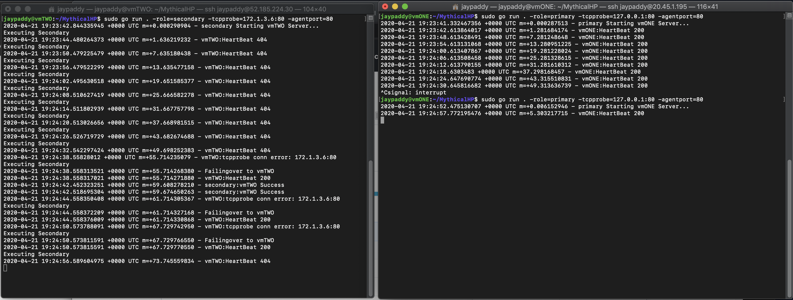
Secondary
Primary
1
Endpoint closed on primary
2
tcp connection from secondary
Primary is back
4
Secondary takes over
3
5
Secondary Stops

Slide 5
LoadBalancer
vmONE
vmTWO
http://0.0.0.0/
http://0.0.0.0/healthprobe
http://vmONE/healthprobe
vmONE Health Probe calls
200 OK
vmONE
http://vmTWO/healthprobe
http://vmONE/healthprobe
vmTWO Health Probe calls – vmONE is UP, hence vmTWO fails in health check
200 OK
404
http://vmTWO/healthprobe
http://vmONE/healthprobe
vmTWO Health Probe calls – vmONE is DOWN and hence vmTWO takes over
400-500
vmTWO
200 OK
http://0.0.0.0/
http://0.0.0.0/healthprobe

Slide 6
LoadBalancer
Node 1
Node 2

